Slide 1
Agenda
Announcements (5 min)
UofSC Update (10 min)
Fraunhofer Update (5 min)
BMW Update / Next Steps(10 min)

Slide 2
Key Points
Interviews
Laptops, SAP and Impacts

Slide 3
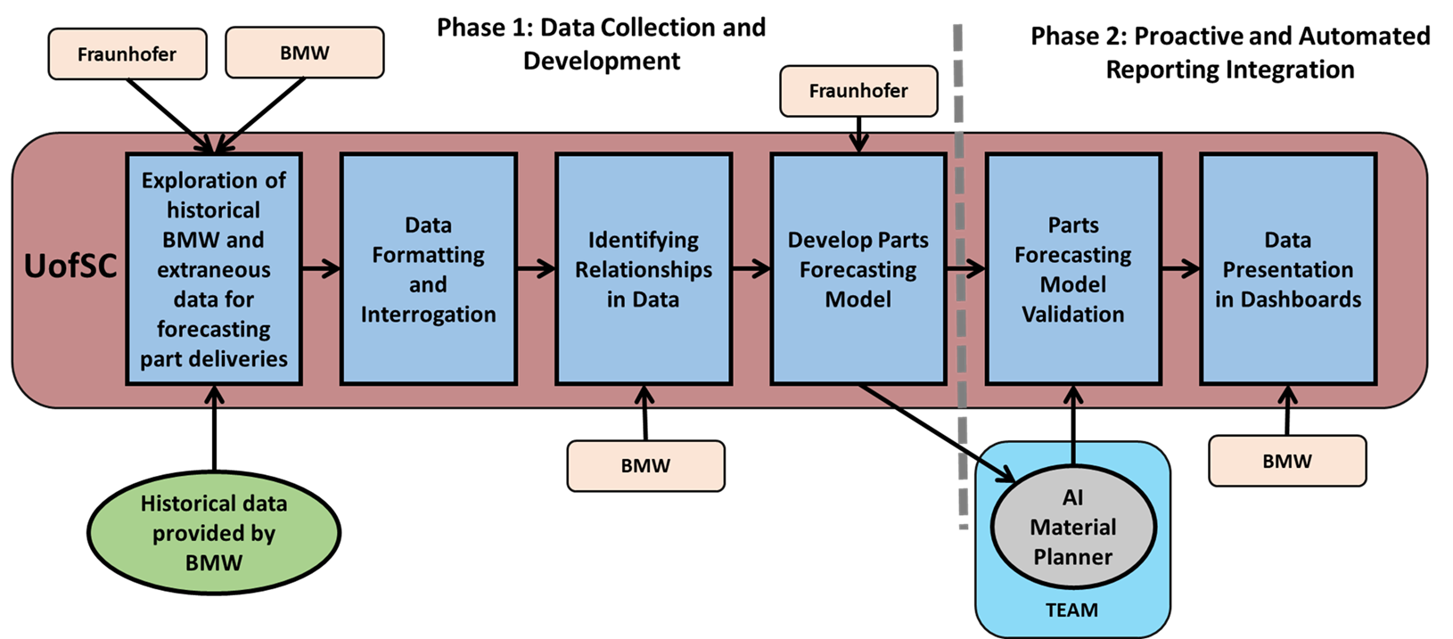
UofSC Team - Status Update for 09/20/2021
UofSC Roadmap
Current Task: Data Exploration
Understand headers (completed)
Get information on quality, ordering times, transportation, etc. (in progress)
Identify poor areas/gaps in data (in progress)
Make timeline of orders (in progress)
Define states (early, tardy, too late) (in progress)
Calculate numbers for tangible and intangible criteria (in progress)
Create supplier ranking (in progress)
Integrate findings into deliverable document
Deliverable: key figures from historical data, rich/poor areas, supplier ranking (Due end of September)
Progress Made Last Week
Plans for this week
Continuing to review the Zgrve and 130 reports
Starting analysis for supplier/part ranking
Preliminary database design
Revising of data dictionary
Preparing for Interviews
Continuing to review the Zgrve and 130 reports and documentation
Continue refinement of data dictionary and database
Conduct first set of Interviews
Work on first deliverable

Slide 4
Detail
Data Dictionary

Slide 5
MPA Weekly Update 09/20 - Fraunhofer
Summary of last week:
Evaluating potential expert-system framework solutions for the recommendation engine
Plans for this week:
Evaluating potential expert-system framework solutions for the recommendation engine
Document the information obtained on the interviews
Proceed with the ER mapping process.
Concerns/Comments:
None

